Slide 1
Eggsplore Oasis: A Nestacular Adventure
Mylee Smith, Ramses Ziane-Cherif, Victoria Pineda, Devin Dubois

Slide 2
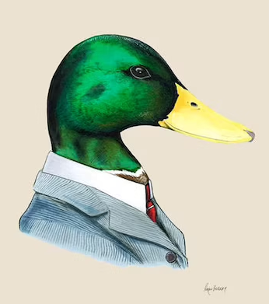

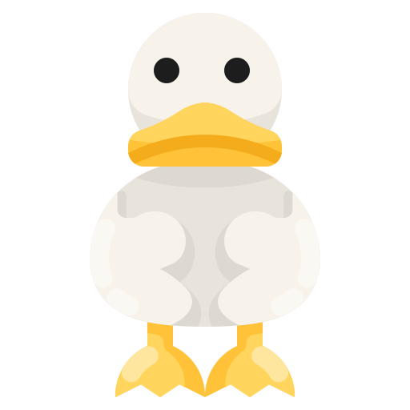
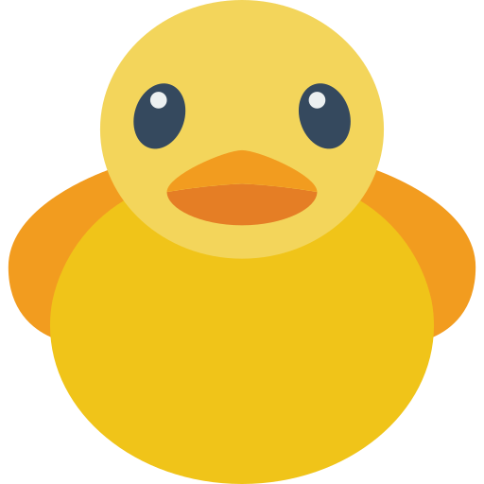
Our Team
Mylee Smith
(visuals/front end)
Devin DuBois (databases/back end)
Victoria Pineda
(research)
Ramses Ziane-Cherif
(back end)

Slide 3
Introduction
We were given the opportunity to aid a charity through software with the choice of what charity we wanted to help, and how we wanted to help them.
Thanks to our majors (CE and CS), we had a preference toward ducks (ahem rubber duck decoding). We found an charity called Ducks Unlimited and decided this was the charity we were going to help.
We decided we were going to help Ducks Unlimited by:
Making educational software to:
Teach people about ducks.
Spread awareness about their habitats and life cycles.
We also planned to help the charity by encouraging users to donate to the charity by:
Incorporating many links throughout our software that led to the donation page of Ducks Unlimited.

Slide 4
Breakdown
We plan to host our educational software online with the goal of making learning about ducks as fun as possible.
Eggsplore Oasis: A Nestacular Adventure is born! A web based game that will teach users about ducks.
The project idea is to make a website where users can go through educational modules in the form of games.
Users will create an account
Account creation will prompt users to design their own personal sprite which will be their character throughout the game.
The game board will show all active users sprites, with each users username displayed above it.
The game board will be:
A water based map of Eggsplore Oasis with 3 islands.
Each island will have multiple entrances to different games.
Users will be able to trigger the beginning of a game when they menuever their sprite to the entrance of a game.

Slide 5

Specifications
User Authentication:
Username/password recovery
Database:
Account Creation:
Username
Email
Password
Sprite creation
Email or username
Password
Username
Email
Password
Sprite
Modules completed
Email

Slide 6
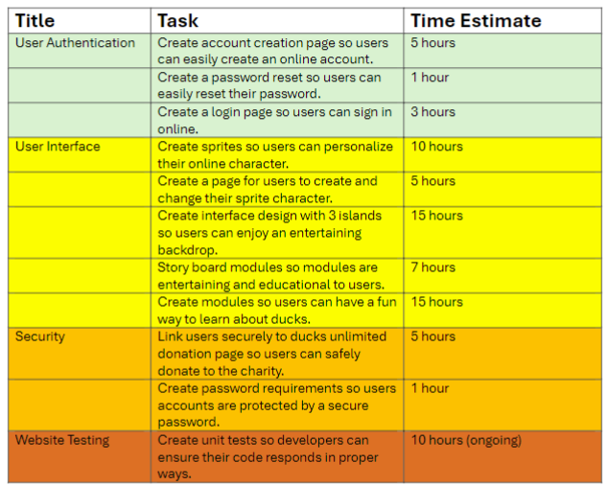
Product Backlog
User Authentication
Create account creation page: 5 hours -> 5 PBI points
Create password reset: 1 hour -> 1 PBI point
Create login page: 3 hours -> 3 PBI points
User Interface
Create sprites: 10 hours -> 8 PBI points
Create page for sprite management: 5 hours -> 5 PBI points
Create interface design with 3 islands: 15 hours -> 13 PBI points
Storyboard modules: 7 hours -> 5 PBI points
Create educational modules about ducks: 15 hours -> 13 PBI points
Security
Link users securely to donation page: 5 hours -> 5 PBI points
Create password requirements: 1 hour -> 1 PBI point
Website Testing
Create unit tests: 10 hours (ongoing) -> 8 PBI points

Slide 7
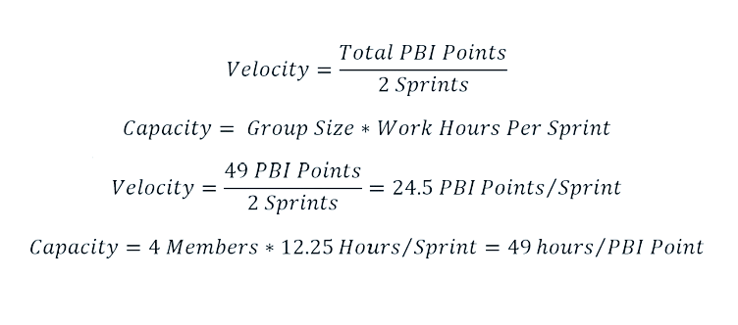
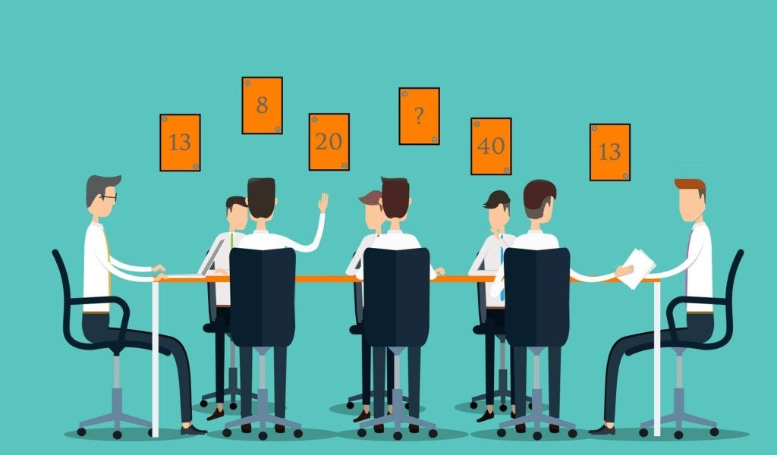
Sprint Backlog Planning Poker Estimations
Notes:
Velocity (how much work needs to be done per sprint) = total number of PBI points / 2 sprints
Capacity (how much work is possible per sprint) = group size * number of hours per week * 2 weeks
Velocity = 49 PBI points / 2 = 24.5 PBI points per sprint
Capacity 4 people * 6.125 hours per week * 2 weeks = 49 hours/PBI points

Slide 8
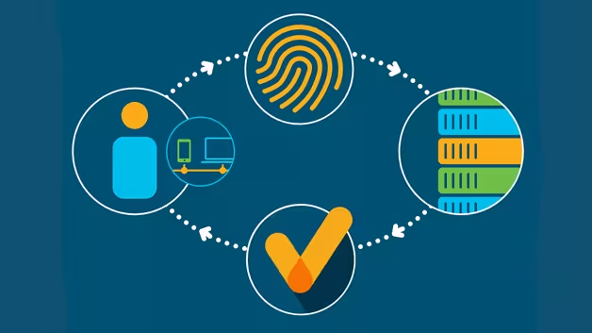
Sprint 1
User Authentication
Create account creation page (5)
Create password reset (1)
Create login page (3)
Part of User Interface
Create sprites (8)
Create page for sprite management (5)
Part of Create interface design with 3 islands (3.5/13)
Total of 24.5 / 49

Slide 9
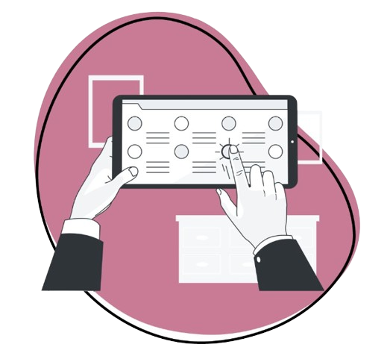
Sprint 2
Part of User Interface
Part of Create interface design with 3 islands (9.5/13)
Storyboard modules (5)
Create educational modules about ducks (13)
Security
Link users securely to donation page (5)
Create password requirements (1)
Website Testing
Total of 24.5 / 49

Slide 10






Frameworks
HTML
Bootstrap
CSS
React
Spring Boot
Oracle SQL

Slide 11
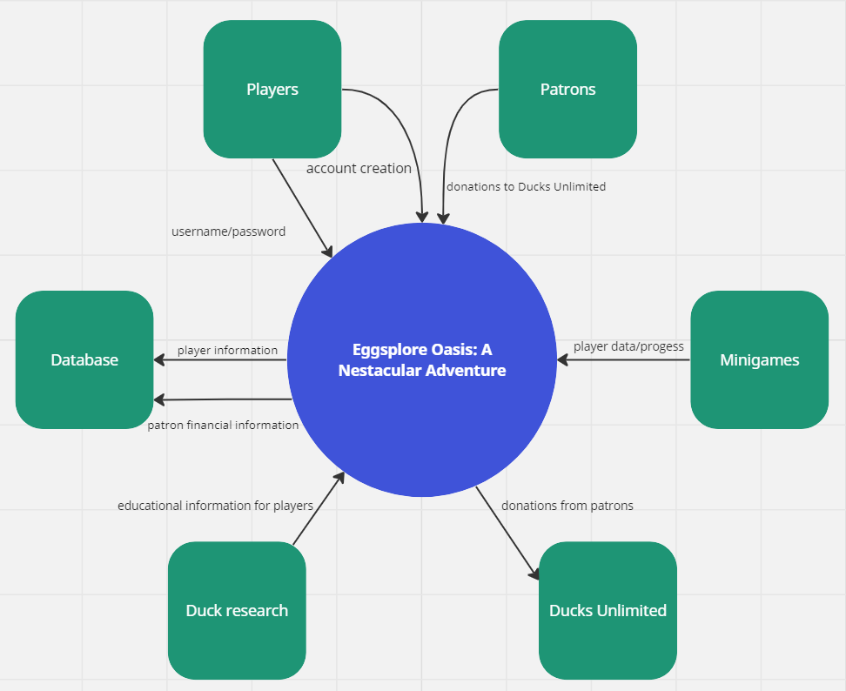
Architectural Design
This is a system context model of our project, which describes what entities the game interacts with, as well as what is being inputted/outputted throughout the system.
Some of the items our system interacts with include:
Players
Patrons
Minigames
Ducks Unlimited
Duck research
Database

Slide 12




Risk Management
Code Security
Database Protection
Quality Assurance
Apply secure coding practices to mitigate the risk of vulnerabilities and exploits
Implement robust access controls to restrict unauthorized access to sensitive data
Conducting frequent code reviews to identify and rectify security loopholes
Team Collaboration
Contingency Planning
Foster open communication within the development team to ensure prompt reporting of risks
Mindfully and consistently updating security protocols to properly handle vulnerabilities
Notes:
Code Security
Apply secure coding practices to mitigate the risk of vulnerabilities and exploits
Database Protection
Implement robust access controls to restrict unauthorized access to sensitive data
Testing and Quality Assurance
Conducting regular code reviews to identify and rectify security loopholes
Team Communication/Collaboration
Foster open communication within the development team to ensure prompt reporting of risks and concerns
Contingency Planning
Mindfully and consistently updating security protocols to properly handle any potential vulnerabilities

Slide 13
User Stories
Young children
Parents
Privacy
As a young player, I want to play fun mini games so that I can be entertained and have a fun experience with the game.
As a parent, I want my children to be able to learn about the environment so that they can understand the importance of conservation.
As a privacy-minded player of your game, I would like my account to be secure so that my data and progress is protected.
Patrons
Nature
As a patron, I would like my financial information to be secure so that after I donate I don’t have to worry about my information getting leaked or misused.
As someone who loves nature, I would like to be more educated on the different species of ducks so that I can know more about each of the duck species when I see them.

Slide 14
Issues & Next Steps
01
02
03
04
User Authentication
User Interface
Security
Website testing
Front end web pages as well as a database for login information
Bulk of the project: art, story, gameplay, research, and sprite design
Password encryption, cybersecurity, secure payment, password requirements
Extensive testing will be done to ensure that an enjoyable, educational, and secure product is delivered

Slide 15
Thanks!
Do you have any questions?
devindubois@ufl.edu mylee.smith@ufl.edu rzianecherif@ufl.edu pinedav@ufl.edu
Please keep this slide for attribution

Slide 16
Slide Distribution
Mylee: 3, 4, 5
Victoria: 8 , 9, 11
Devin: 6, 7, 13
Ramses: 10, 12, 14

